Slide 1
Lecture # 17
Multivariable Calculus
Week - 9
Instructor: Ali Haider Shah
School of Computer Science & IT (SCIT)
Beaconhouse National University (BNU), Lahore

Slide 2


12
Vectors and the Geometry
of Space
Copyright © Cengage Learning. All rights reserved.

Slide 3

12.5
Equations of Lines and Planes
Copyright © Cengage Learning. All rights reserved.

Slide 4
Equations of Lines and Planes
A line in the xy-plane is determined when a point on the line and the direction of the line (its slope or angle of inclination) are given.
The equation of the line can then be written using the
point-slope form.
Likewise, a line L in three-dimensional space is determined when we know a point P₀(x₀, y₀, z₀) on L and the direction of L. In three dimensions the direction of a line is conveniently described by a vector, so we let v be a vector parallel to L.

Slide 5



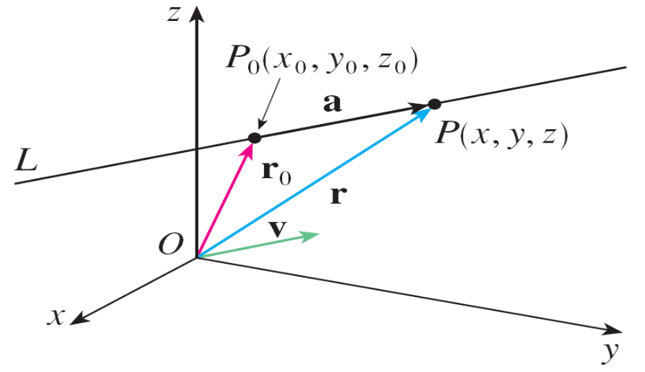
Equations of Lines and Planes
Let P(x, y, z) be an arbitrary point on L and let r₀ and r be the position vectors of P₀ and P (that is, they have
representations and ).
If a is the vector with representation as in Figure 1,
then the Triangle Law for vector addition gives r = r₀ + a.
Figure 1

Slide 6


Equations of Lines and Planes
But, since a and v are parallel vectors, there is a scalar t such that a = t v. Thus
which is a vector equation of L.
Each value of the parameter t gives the position vector r
of a point on L. In other words, as t varies, the line is traced out by the tip of the vector r.

Slide 7
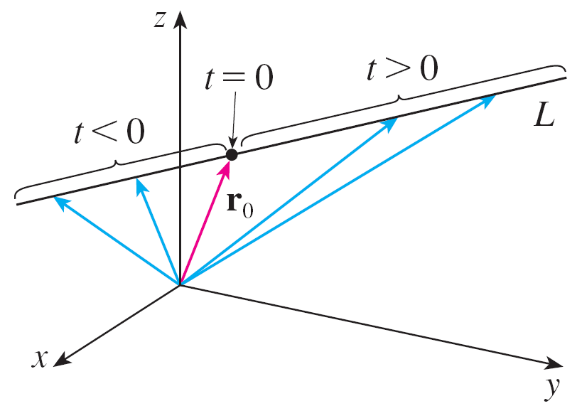
Equations of Lines and Planes
As Figure 2 indicates, positive values of t correspond to points on L that lie on one side of P₀, whereas negative values of t correspond to points that lie on the other side of P₀.
Figure 2

Slide 8

Equations of Lines and Planes
If the vector v that gives the direction of the line L is written
in component form as v = ⟨a, b, c⟩, then we have
t v = ⟨t a, t b, t c⟩.
We can also write r = ⟨x, y, z⟩ and r₀ = ⟨x₀, y₀, z₀⟩, so the vector equation becomes
⟨x, y, z⟩ = ⟨x₀ + t a, y₀ + tb, z₀ + t c⟩
Two vectors are equal if and only if corresponding components are equal.

Slide 9



Equations of Lines and Planes
Therefore we have the three scalar equations:
where t ∈
These equations are called parametric equations of the
line L through the point P₀(x₀, y₀, z₀) and parallel to the
vector v = ⟨a, b, c⟩.
Each value of the parameter t gives a point (x, y, z) on L.

Slide 10
Example 1
(a) Find a vector equation and parametric equations for the
line that passes through the point (5, 1, 3) and is
parallel to the vector i + 4j – 2k.
(b) Find two other points on the line.
Solution:
(a) Here r₀ = ⟨5, 1, 3⟩ = 5i + j + 3k and v = i + 4j – 2k, so
the vector equation becomes
r = (5i + j + 3k) + t(i + 4j – 2k)
or r = (5 + t) i + (1 + 4t) j + (3 – 2t) k

Slide 11
Example 1 – Solution
cont’d
Parametric equations are
x = 5 + t y = 1 + 4t z = 3 – 2t
(b) Choosing the parameter value t = 1 gives x = 6, y = 5,
and z = 1, so (6, 5, 1) is a point on the line.
Similarly, t = –1 gives the point (4, –3, 5).

Slide 12
Equations of Lines and Planes
The vector equation and parametric equations of a line are
not unique. If we change the point or the parameter or
choose a different parallel vector, then the equations change.
For instance, if, instead of (5, 1, 3), we choose the point
(6, 5, 1) in Example 1, then the parametric equations of the line become
x = 6 + t y = 5 + 4t z = 1 – 2t

Slide 13
Equations of Lines and Planes
Or, if we stay with the point (5, 1, 3) but choose the parallel vector 2i + 8j – 4k, we arrive at the equations
x = 5 + 2t y = 1 + 8t z = 3 – 4t
In general, if a vector v = ⟨a, b, c⟩ is used to describe the direction of a line L, then the numbers a, b, and c are called direction numbers of L.
Since any vector parallel to v could also be used, we see that any three numbers proportional to a, b, and c could also be used as a set of direction numbers for L.

Slide 14
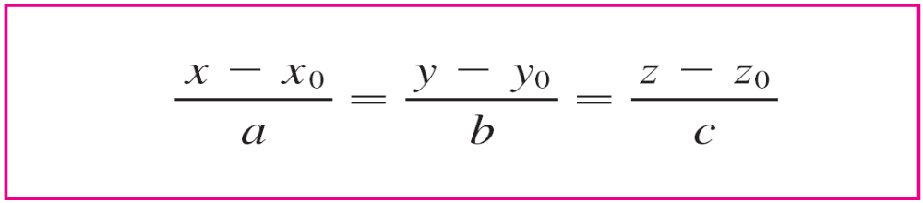

Equations of Lines and Planes
Another way of describing a line L is to eliminate the
parameter t from Equations 2.
If none of a, b, or c is 0, we can solve each of these
equations for t, equate the results, and obtain
These equations are called symmetric equations of L.

Slide 15
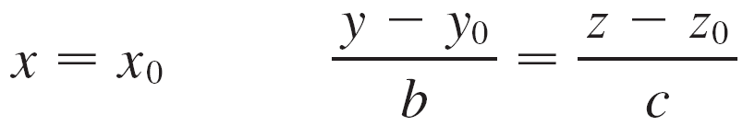
Equations of Lines and Planes
Notice that the numbers a, b, and c that appear in the denominators of Equations 3 are direction numbers of L, that is, components of a vector parallel to L.
If one of a, b, or c is 0, we can still eliminate t. For
instance, if a = 0, we could write the equations of L as
This means that L lies in the vertical plane x = x₀.

Slide 16

Equations of Lines and Planes
In general, we know from Equation 1 that the vector equation of a line through the (tip of the) vector r₀ in the direction of a vector v is r = r₀ + t v.
If the line also passes through (the tip of) r₁, then we can take v = r₁ – r₀ and so its vector equation is
r = r₀ + t(r₁ – r₀) = (1 – t)r₀ + tr₁
The line segment from r₀ to r₁ is given by the parameter interval 0 ≤ t ≤ 1.

Slide 17
Practice Questions

Slide 18
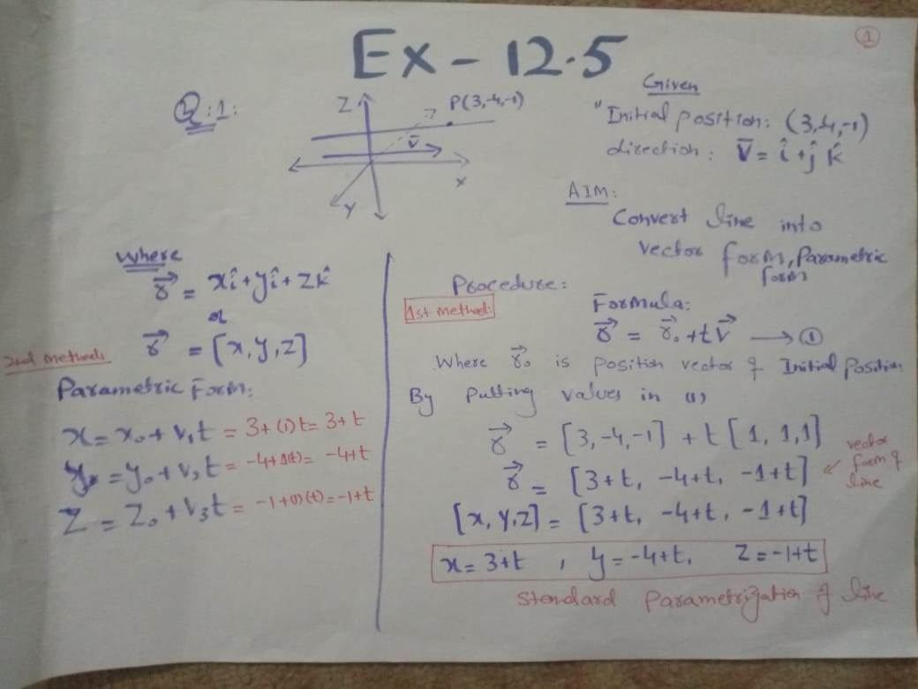

Slide 19
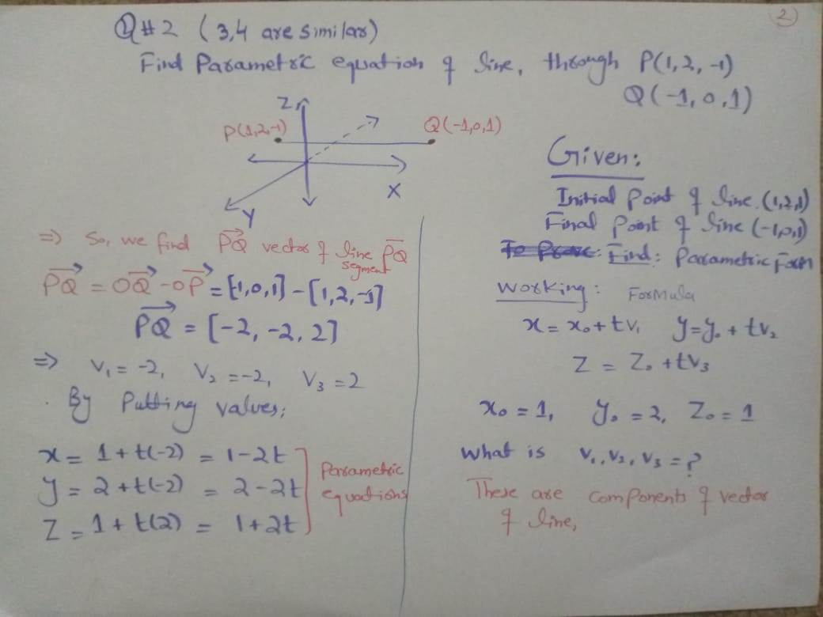

Slide 20
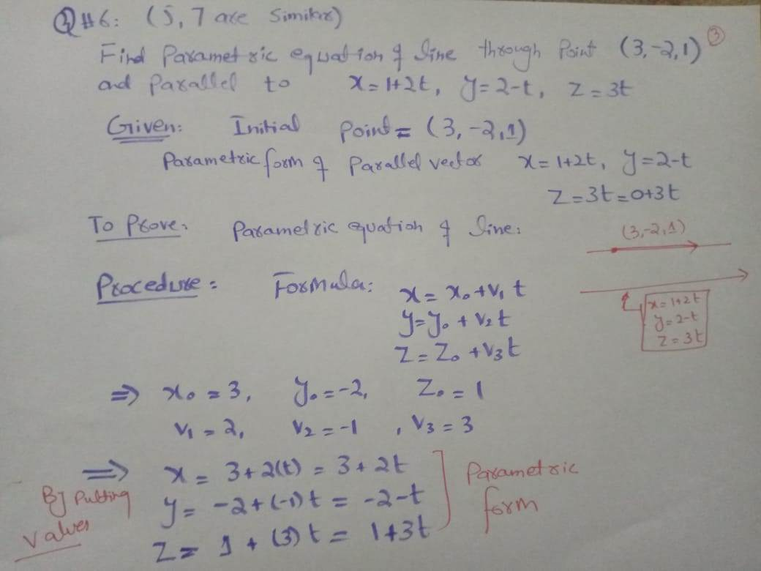

Slide 21
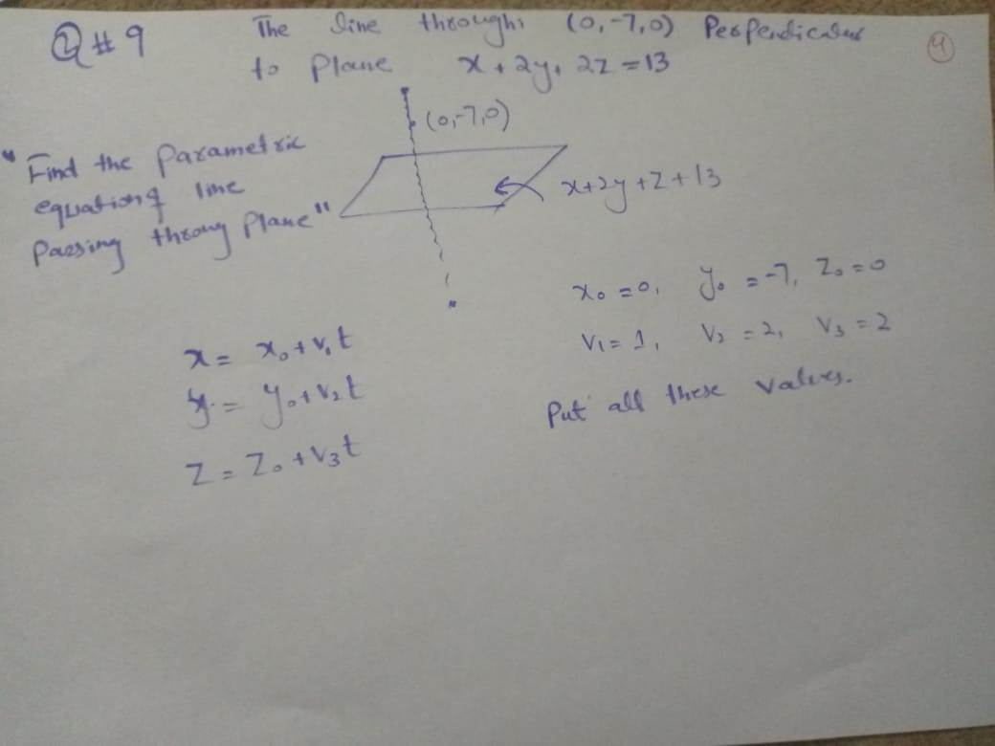

Slide 22
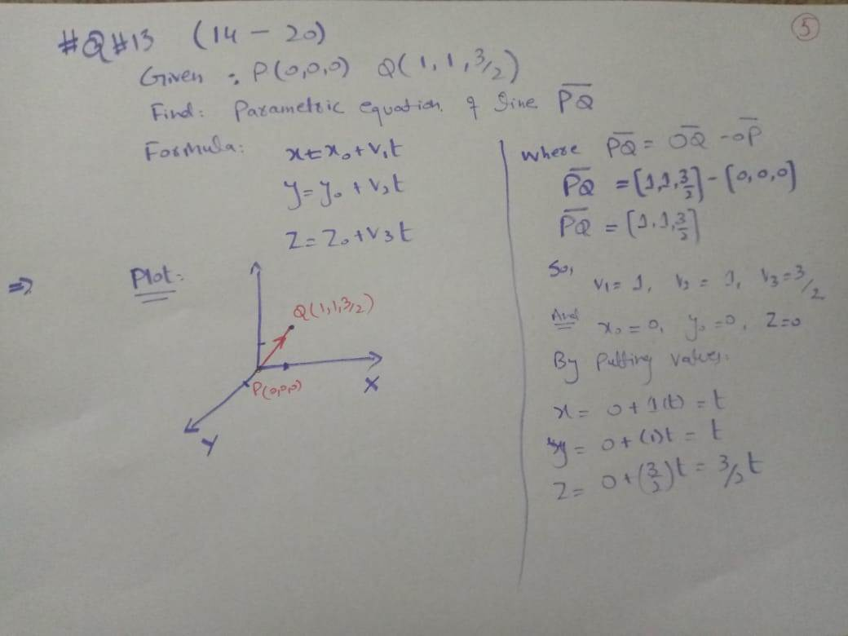

Slide 23
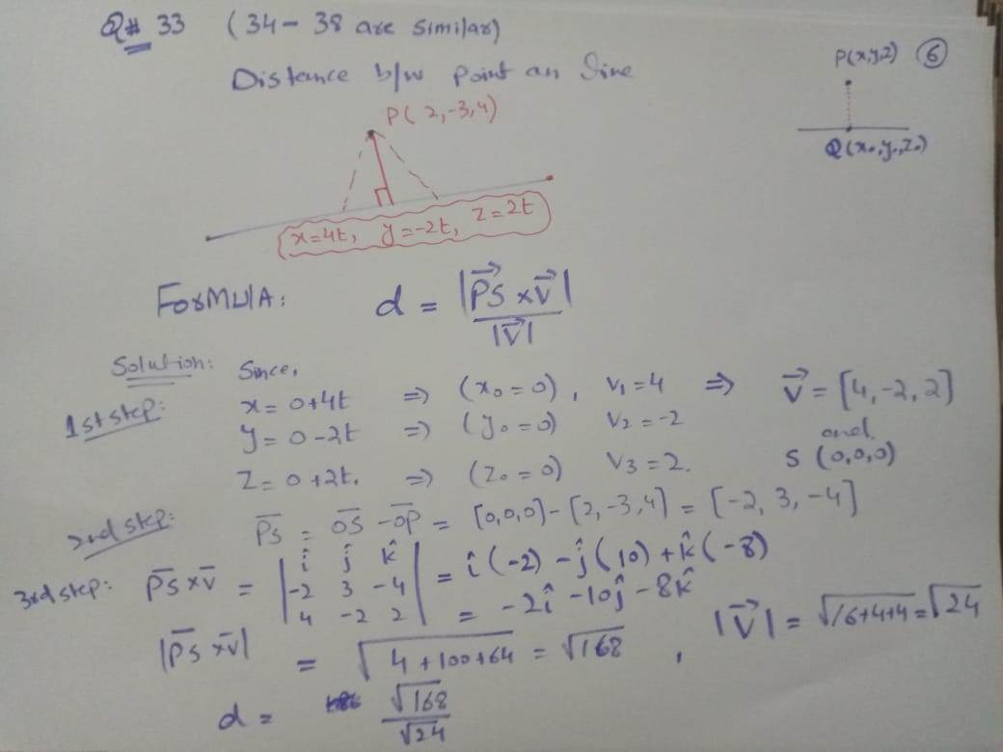

Slide 24
Planes

Slide 25
Planes
Although a line in space is determined by a point and a direction, a plane in space is more difficult to describe.
A single vector parallel to a plane is not enough to convey the “direction” of the plane, but a vector perpendicular to the plane does completely specify its direction.
Thus a plane in space is determined by a point P₀(x₀, y₀, z₀) in the plane and a vector n that is orthogonal to the plane.
This orthogonal vector n is called a normal vector.

Slide 26

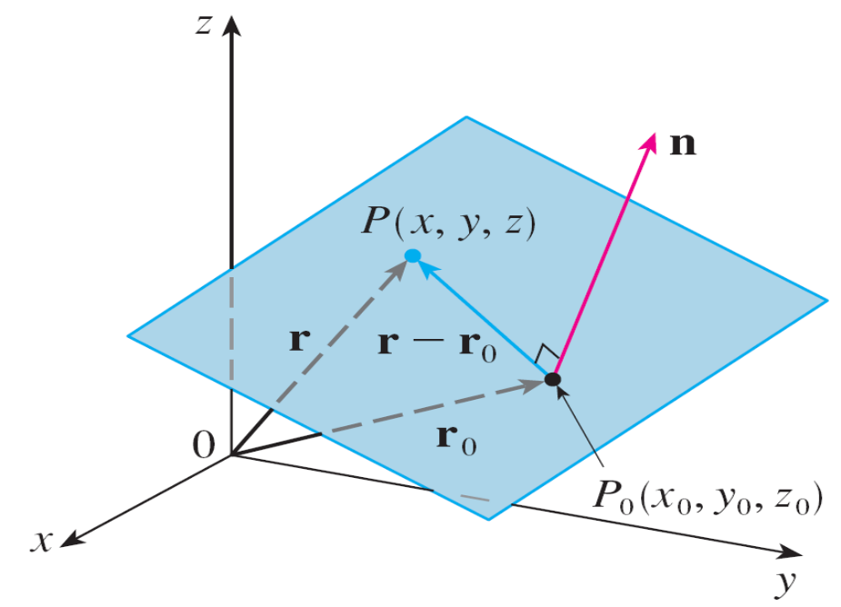
Planes
Let P(x, y, z) be an arbitrary point in the plane, and let
r₀ and r be the position vectors of P₀ and P.
Then the vector r – r₀ is represented by (See Figure 6.)
Figure 6

Slide 27




Planes
The normal vector n is orthogonal to every vector in the given plane. In particular, n is orthogonal to r – r₀ and so we have
which can be rewritten as
Either Equation 5 or Equation 6 is called a vector equation of the plane.

Slide 28



Planes
To obtain a scalar equation for the plane, we write
n = ⟨a, b, c⟩, r = ⟨x, y, z⟩, and r₀ = ⟨x₀, y₀, z₀⟩.
Then the vector equation becomes
⟨a, b, c⟩ • ⟨x – x₀, y – y₀, z – z₀⟩ = 0
or
Equation 7 is the scalar equation of the plane through P₀(x₀, y₀, z₀) with normal vector n = ⟨a, b, c⟩.

Slide 29
Example 4
Find an equation of the plane through the point (2, 4, –1) with normal vector n = ⟨2, 3, 4⟩. Find the intercepts and sketch the plane.
Solution:
Putting a = 2, b = 3, c = 4, x₀ = 2, y₀ = 4, and z₀ = –1 in Equation 7, we see that an equation of the plane is
2(x – 2) + 3(y – 4) + 4(z + 1) = 0
or 2x + 3y + 4z = 12
To find the x-intercept we set y = z = 0 in this equation and obtain x = 6.

Slide 30
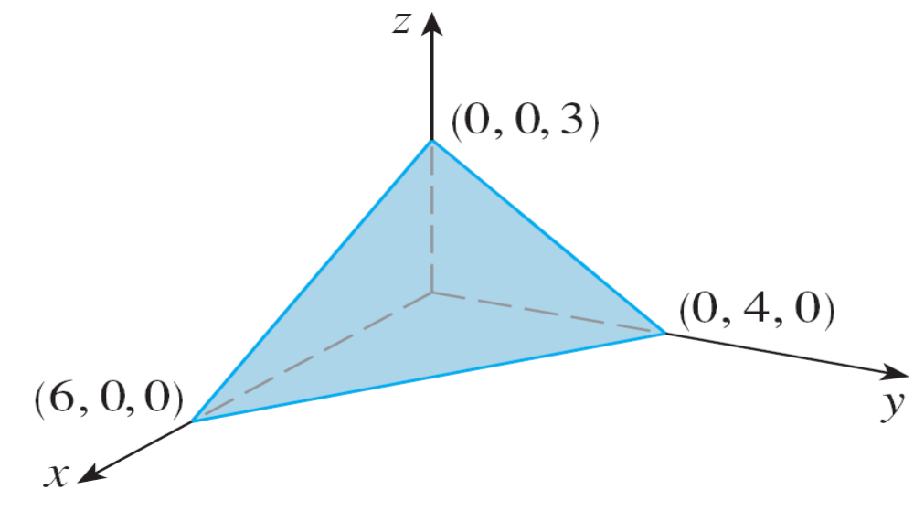
Example 4 – Solution
cont’d
Similarly, the y-intercept is 4 and the z-intercept is 3. This enables us to sketch the portion of the plane that lies in the first octant (see Figure 7).
Figure 7

Slide 31



Planes
By collecting terms in Equation 7 as we did in Example 4, we can rewrite the equation of a plane as
where d = –(ax₀ + by₀ + cz₀).
Equation 8 is called a linear equation in x, y, and z. Conversely, it can be shown that if a, b, and c are not all 0, then the linear equation represents a plane with normal vector ⟨a, b, c⟩.

Slide 32
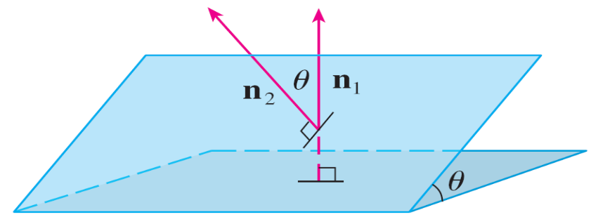
Planes
Two planes are parallel if their normal vectors are parallel.
For instance, the planes x + 2y – 3z = 4 and
2x + 4y – 6z = 3 are parallel because their normal vectors are n₁ = ⟨1, 2, –3⟩ and n₂ = ⟨2, 4, –6⟩ and n₂ = 2n₁.
If two planes are not parallel,
then they intersect in a straight
line and the angle between the
two planes is defined as the
acute angle between their
normal vectors
(see angle θ in Figure 9).
Figure 9

